Slide 1
PROJECT - 9
NextHikes IT Solutions Project 9 : LLM Project: Building a News Research Tool
Name – SANTOSH
Mobile no – 8377011874
Batch - Digicrome Academy | Data Science and AI | N-140724-E8-SS-27
T

Slide 2
Project Tasks Phase 1: Environment Setup 1. Task 1.1: Install Required Libraries ○ Command: pip install langchain openai streamlit newsapi-python 2. Task 1.2: Obtain API Keys Get OpenAI API key from the OpenAI website. [Procedure] Get NewsAPI key from the NewsAPI website. [Procedure]

Slide 3
Phase 2: LangChain Configuration Task 2.1: Create LangChain Configuration File Task 2.2: Initialize OpenAI API in langchain_config.py from langchain import OpenAI, LLMChain, PromptTemplate openai_api_key = 'your-openai-api-key' openai = OpenAI(api_key=openai_api_key)

Slide 4
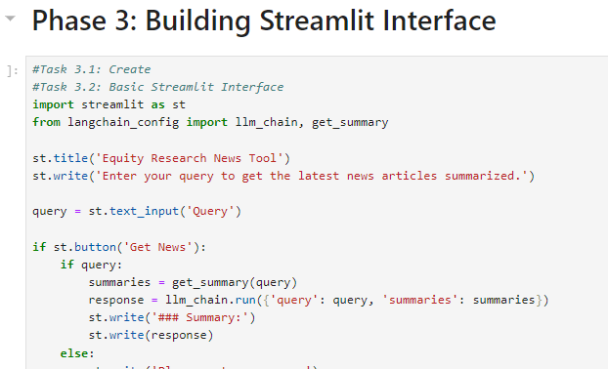
Phase 3: Building Streamlit Interface
Task 3.1: Create Streamlit App File
Task 3.2: Implement Basic Streamlit Interface in app.py

Slide 5
Phase 4: Enhancing the Tool
Task 4.1: Integrate NewsAPI in
Task 4.2: Update Streamlit App to Use Enhanced LangChain Configuration
import streamlit as st
from langchain_config import llm_chain, get_summary
st.title('Equity Research News Tool')
st.write('Enter your query to get the latest news articles summarized.')

Slide 6
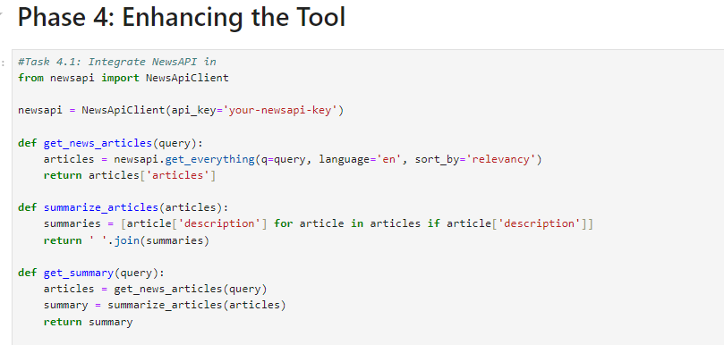

Slide 7
Phase 5: Testing and Validation
1. Task 5.1: Test Basic Functionality
Ensure the app runs without errors.
Verify that entering a query returns summarized news articles.
2. Task 5.2: Validate News Summarization
Check the accuracy and relevance of the summaries generated by the tool.

Slide 8
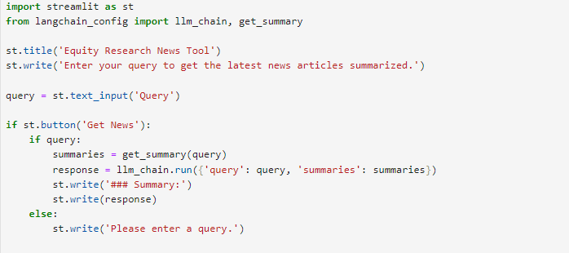

Slide 9
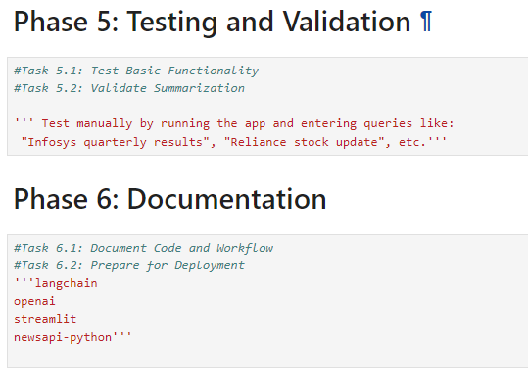

Slide 10
THANKYOU

